Slide 1

Data Visualisation: Empowering Business with Effective Insights

Slide 2
Introduction
Hello, My name is Naheeda Parveen. Today, I’ll walk you through my findings, which directly address the questions posed by the CEO and CMO.
Before diving into the results, let me briefly explain the process to ensure you’re confident in the accuracy and reliability of this analysis.

Slide 3
Data Preparation
I began by importing the dataset into Power BI. A crucial first step was cleaning the data to eliminate errors. Specifically:
I filtered out entries where the quantity was less than 1, as these represented product returns.
I excluded records with unit prices below $0, which were clear data entry errors.

Slide 4
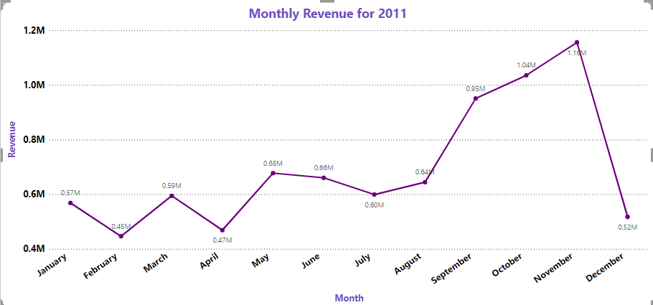

Question 1: Revenue Trends for 2011 The CEO requested a granular view of revenue for 2011, broken down by month, to identify seasonal trends.
The line chart on Tab 1 illustrates the monthly revenue.
Insights:
Revenue peaked in November, likely driven by [seasonal events like holiday shopping or sales promotions].
A noticeable dip occurred in February, which might indicate lower engagement post-holidays or off-season impact

Slide 5
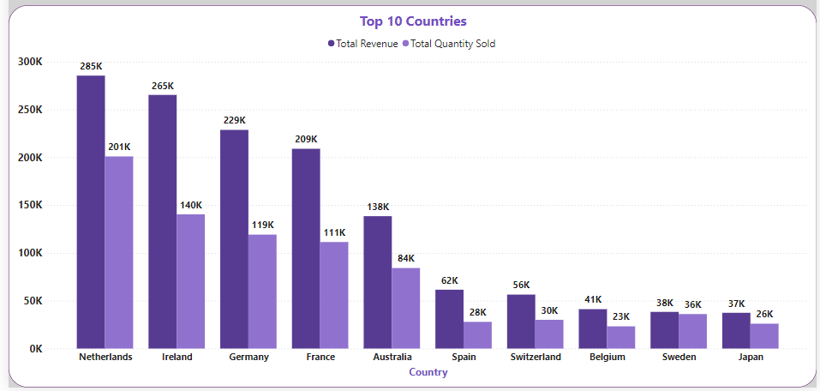
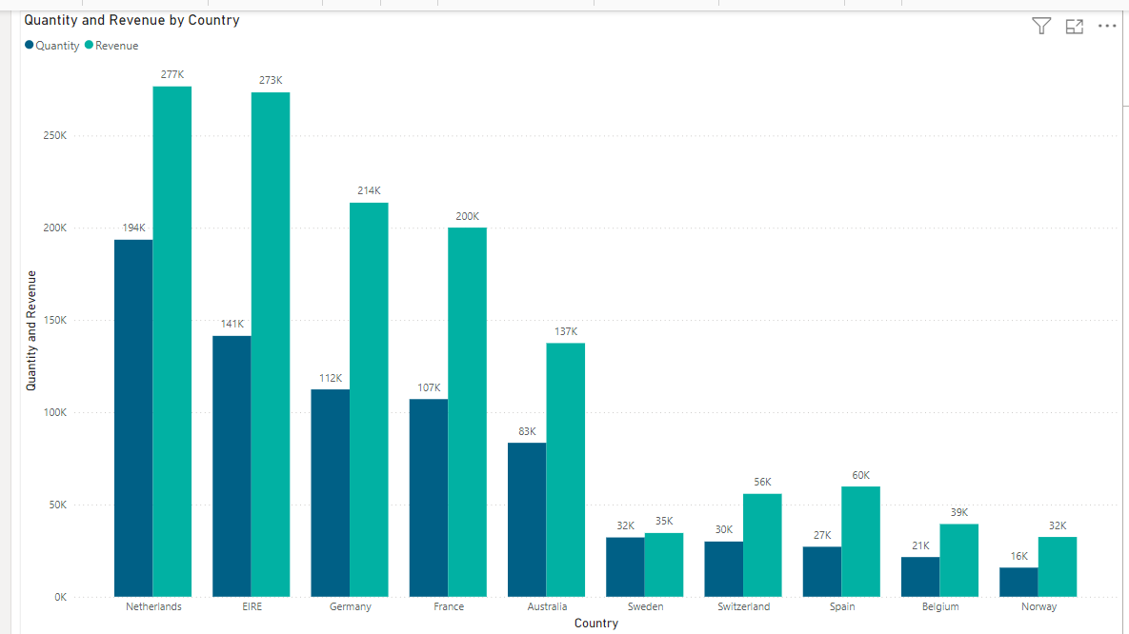
Question 2: Top 10 Countries by Revenue (Excluding the UK) The CMO wanted to see the top 10 countries generating the most revenue, excluding the UK, along with the quantities sold.
On Tab 2, I’ve created a clustered bar chart that compares revenue and quantities sold for these countries.
Key insights:
[Country X] tops the list with a revenue of [$X], followed closely by [Country Y], which sold a higher quantity but generated slightly less revenue.
This suggests an opportunity to explore pricing strategies in [Country Y] to align revenue with its high sales volume.

Slide 6
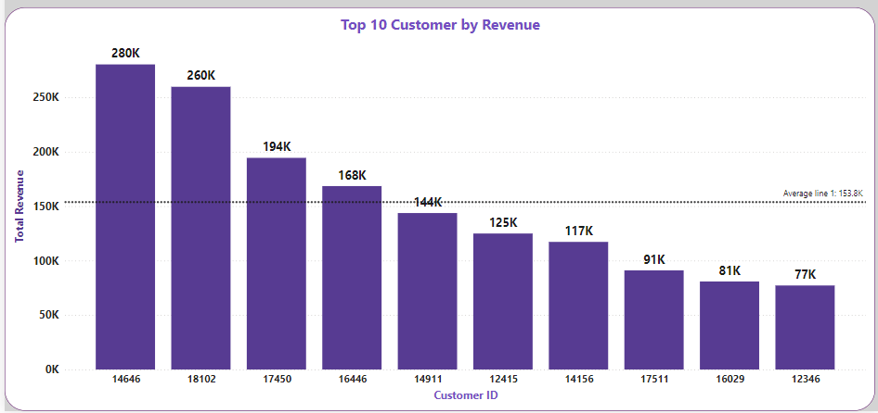
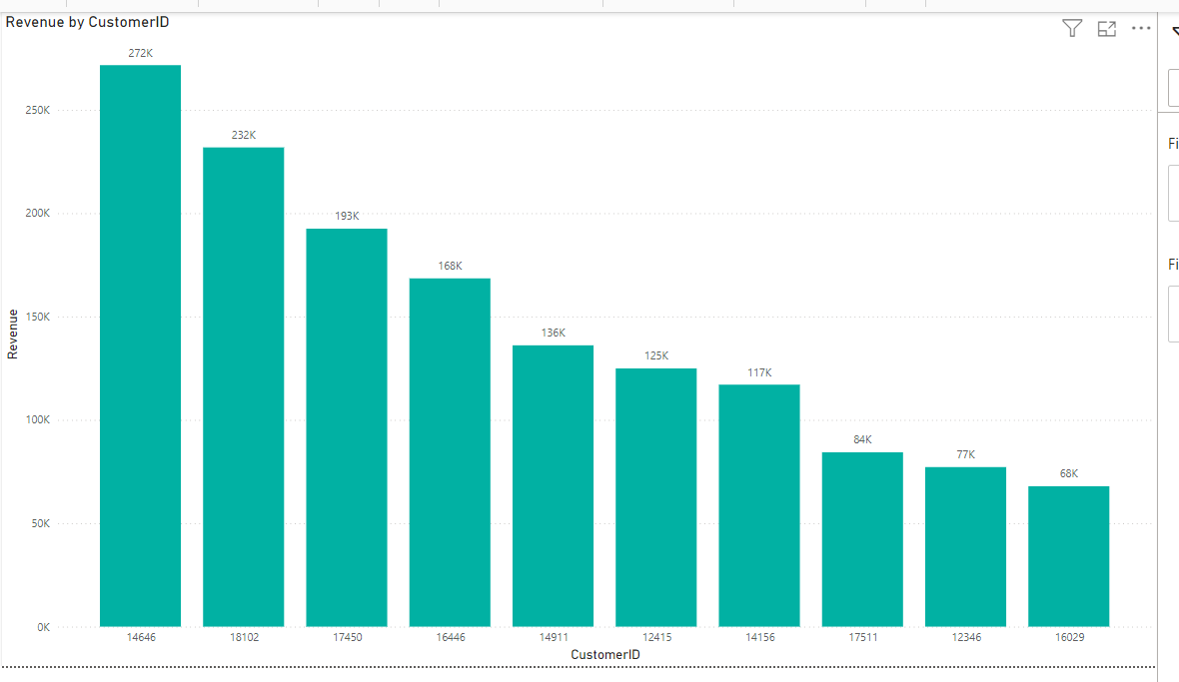
Question 3: Top 10 Customers by Revenue For the CMO’s focus on top customers, I created a descending bar chart on Tab 3.
The visual highlights the top 10 revenue-generating customers.
Key findings:
Customer ID 14646 is the highest revenue generator, contributing 272K, followed by Customer ID 18102.
The decline in revenue from the top to the 10th customer suggests that the top few customers are pivotal to sustaining growth.

Slide 7
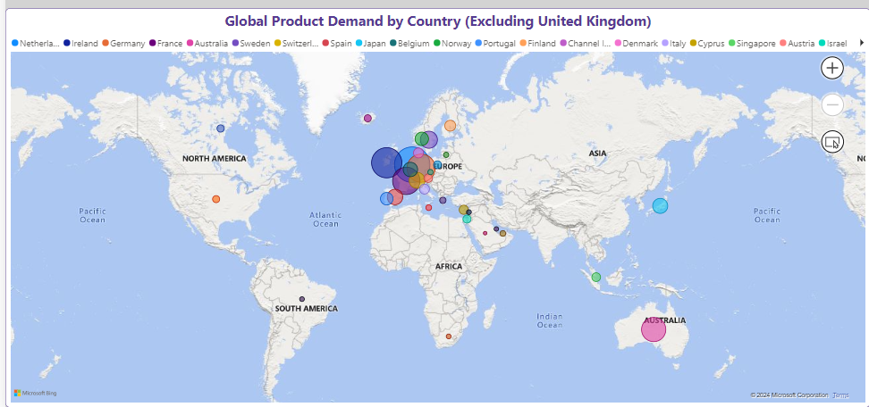
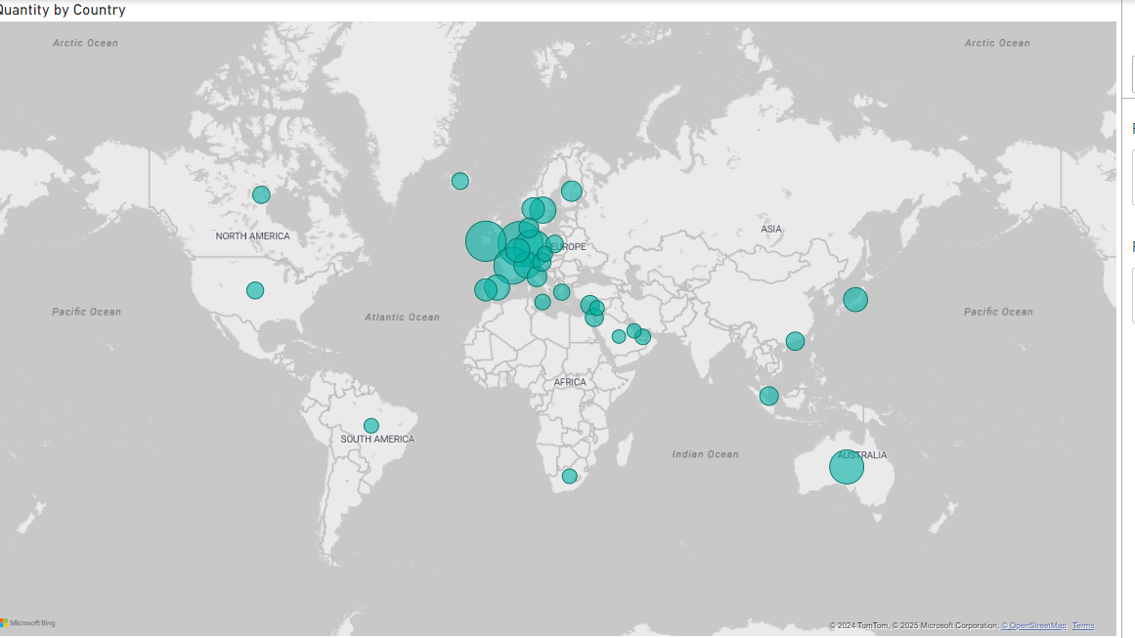
Question 4: Regional Demand Analysis (Excluding the UK)
The bubble map shows that Europe has the highest demand, followed by Australia and North America. These regions should remain a priority for maintaining customer satisfaction.
Lower demand regions like Asia, South America, and Africa represent untapped opportunities for expansion. Targeted marketing and partnerships in these areas could boost sales and grow the customer base.
The CEO can focus on strengthening existing high-demand markets while exploring strategic growth in underserved regions.

Slide 8
Strategic Recommendations
The company should develop strategies focused on maintaining seasonal product inventory to capitalize on increased demand and boost sales during peak seasons
The company should deeply analyze the products that are in high demand and come up with more marketing strategies
The company should explore offering incentives to its highest revenue generating customers
The European market offers significant growth potential, and the company should focus on implementing strategies aimed at enhancing its market presence and its positioning in the market
For low revenue markets, company should do a proper market research and boost marketing efforts.

